Slide 1
COVID-19 DATA ANALYSIS AND FORECASTING
STUDENT DETAILS
REAHAAN SHERIFF I
2019202045
MCA-R 3yrs
Project guide
Ms.P.S.Apirajitha

Slide 2
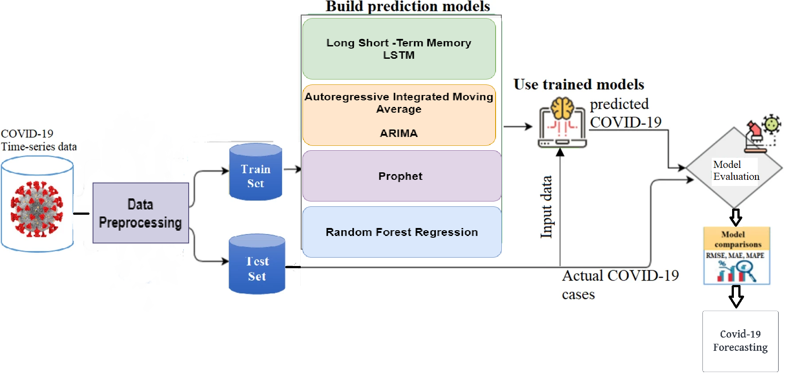
OVERALL ARCHITECTURE

Slide 3
LIST OF MODULES
1. DATA PREPROCESSING
Data preprocessing is a process of preparing the raw data and making it suitable for a machine learning model.
Read Dataset
Parse dates
Split data into training and testing
Scale the data to make data points generalized between (0 and 1)

Slide 4
LIST OF MODULES
2. BUILDING MODEL
LSTM - The model has an input layer followed by three LSTM layers.
The LSTM layers contain Dropout as 0.2 to prevent overfitting in the model.
The output layer consists of a dense layer with 1 neuron.
will predict the number of Corona cases, so our output will be a positive number (0, ∞).

Slide 5
LIST OF MODULES
PROPHET is a procedure for forecasting time series data that was created by Facebook’s Core Data Science team.
It is used for forecasting univariate time series by decomposing the time series into pieces.

Slide 6
LIST OF MODULES
ARIMA (Auto Regressive Integrated Moving Average)
This models also provides good results for time series forecasting.
AR – Auto regressive forecast a series based on the past values in the series called logs.
MA – Moving average forecast a series based on the past errors in the series called error logs.

Slide 7
LIST OF MODULES
Random Forest is a popular machine learning algorithm that belongs to the supervised learning technique.
It can be used for both Classification and Regression problems in ML.
It is based on the concept of ensemble learning,
which is a process of combining multiple classifiers to solve a complex problem and to improve the performance of the model.

Slide 8
LIST OF MODULES
3. TRAINING MODEL
To train the model, we will take out training data (80%) and used 20% of it as validation data

Slide 9
LIST OF MODULES
4. MODEL EVALUATION
It estimates how well (or how bad) the model is, in terms of its ability in mapping the relationship between X (a feature, or independent variable, or predictor variable) and Y (the target, or dependent variable, or response variable).
Mean Absolute Error(MAE)
Mean Squared Error(MSE)
Root Mean Squared Error (RMSE)

Slide 10
LIST OF MODULES
5. FORECASTING PREDICTION
By seeing the results of evaluation metrics, the better performed model will be used for future forecasting.

Slide 11
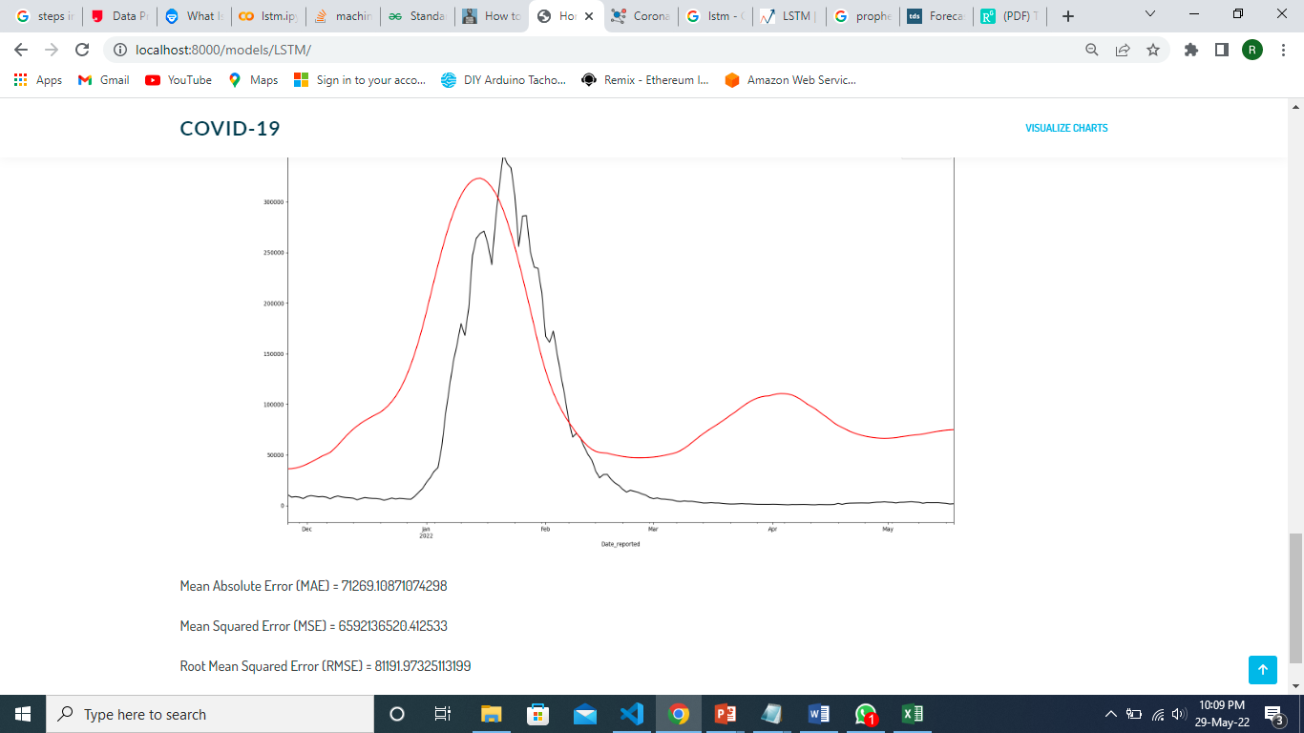
MODULE BASED OUTPUT SCREENSHOTS LSTM Model

Slide 12
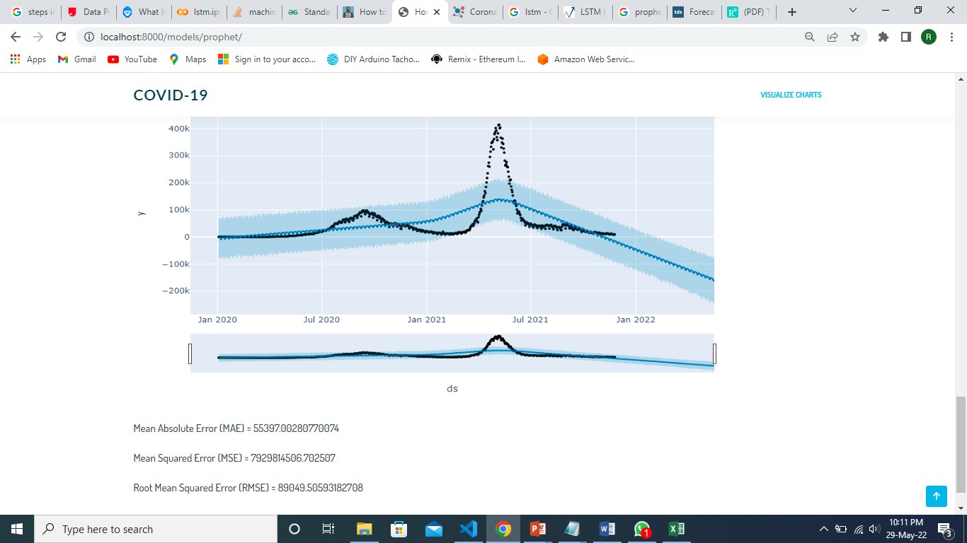
Prophet model

Slide 13
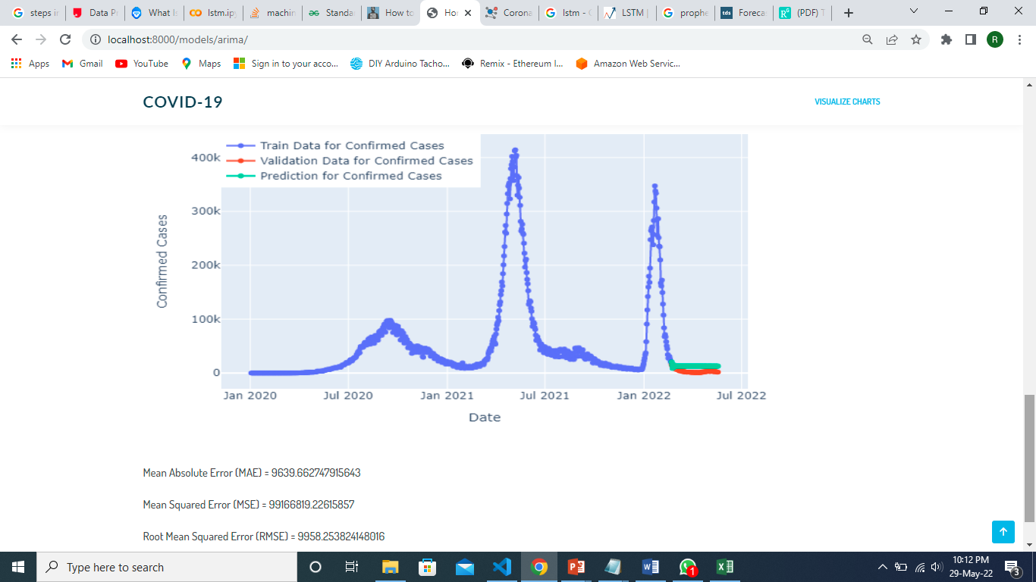
ARIMA model

Slide 14
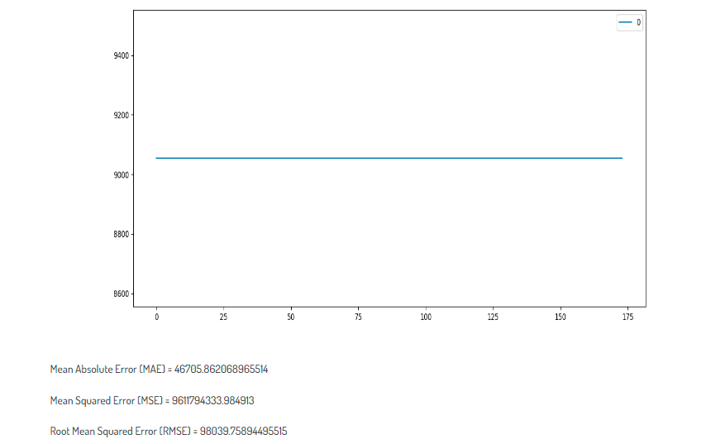
RANDOM fOREST

Slide 15
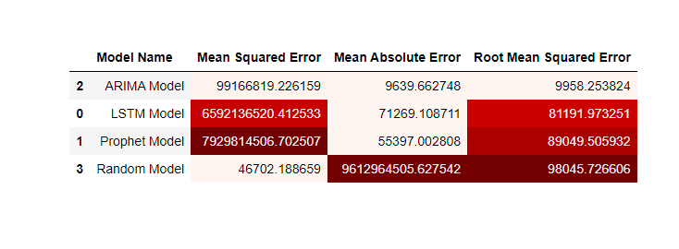
Evaluation metrics

Slide 16
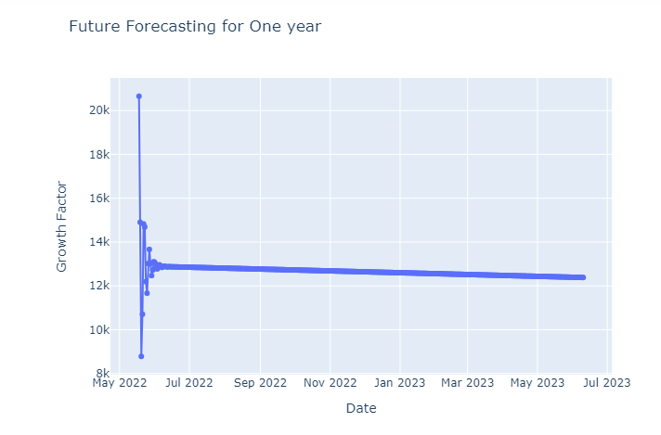
FORECASTING USING ARIMA

Slide 17
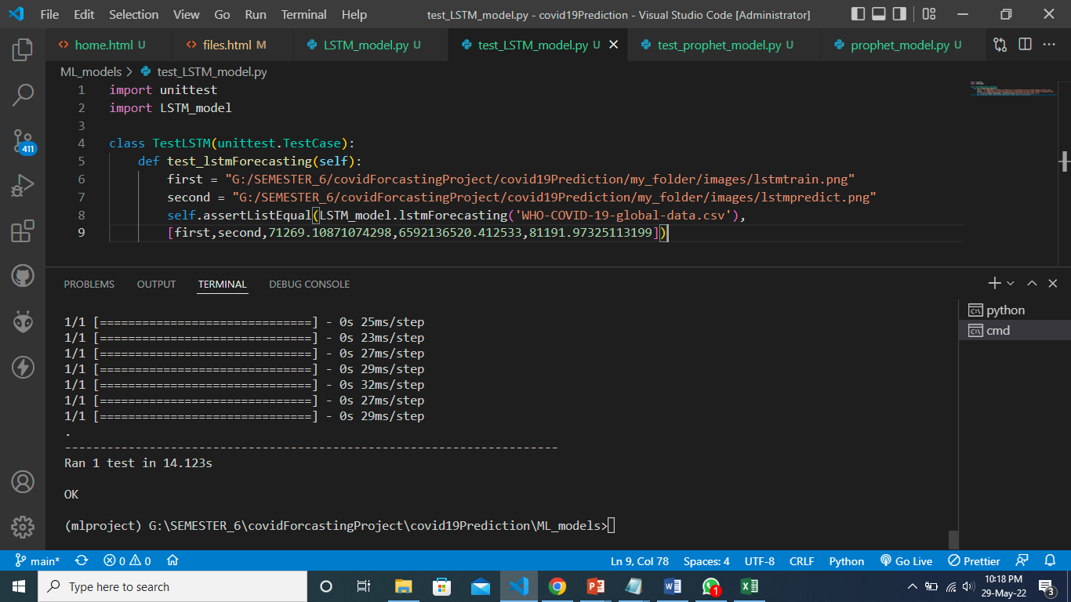
UNIT TESTING LSTM model

Slide 18
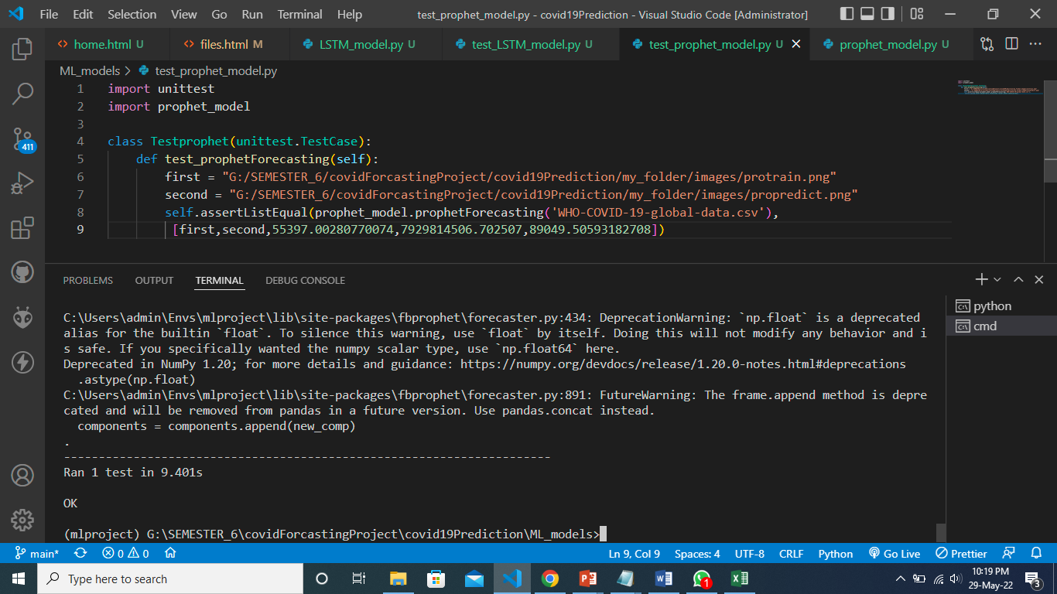
UNIT TESTING Prophet model

Slide 19
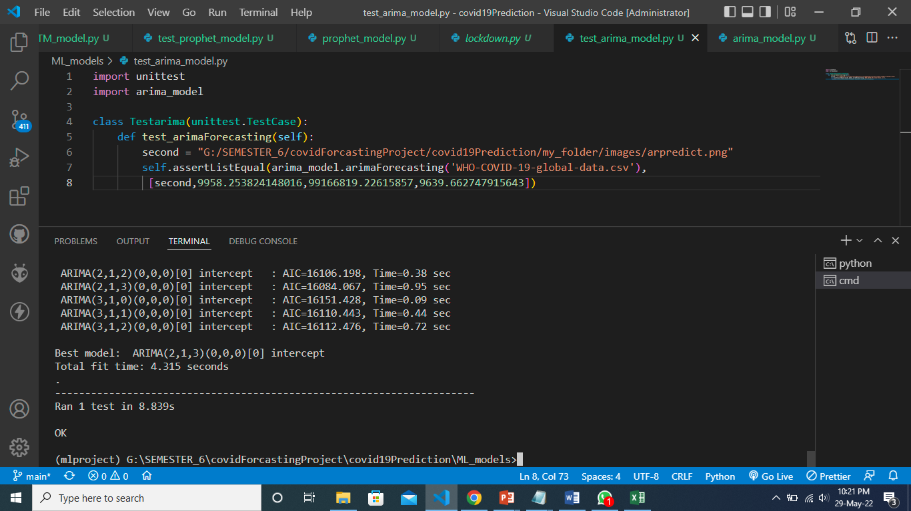
UNIT TESTING ARIMA model

Slide 20
REFERENCES
Wang J., Liu Y., Wei Y., Xia J., Yu T., Zhang X., Zhang L. Epidemiological and clinical characteristics of 99 cases of 2019 novel coronavirus pneumonia in Wuhan, China: a descriptive study. Lancet. 2020;395(10223):507–513.
JA Backer, D Klinkenberg and J. Wallinga, Incubation period of 2019 novel coronavirus (2019-nCoV) infections among travellers from Wuhan, China, 20–28 January 2020.
Tolga Ergen and Suleyman Serdar Kozat, "Efficient online learning algorithms based on LSTM neural networks", IEEE transactions on neural networks and learning systems, vol. 29, no. 8, pp. 3772-3783, 2017.

Slide 21
THANK YOU

